Slide 1


DATA NETWORKS
LESSON 4
The Transport Layer
Application Layer
2-<number>

Slide 2
Transport layer
Learning outcomes:
Learn about OSI transport layer protocols.
  TCP
  UDP
Understand the principles behind transport layer services:
  Understand the key features in TCP
  Understand the key concepts of the UDP .
Computer Networking: A Top-Down Approach. 7th edition. Jim Kurose, Keith Ross – Pearson (2017).
Application Layer
2-<number>

Slide 3
Transport services and protocols
The transport layer is the 4th layer in the OSI model.
It’s the layer that enables end-to-end communication between applications on different devices in a network.
Port Addressing: uses port numbers to identify the application processes (sockets).
It uses 2 main protocols TCP and UDP.
Transport Layer
3-<number>4

Slide 4
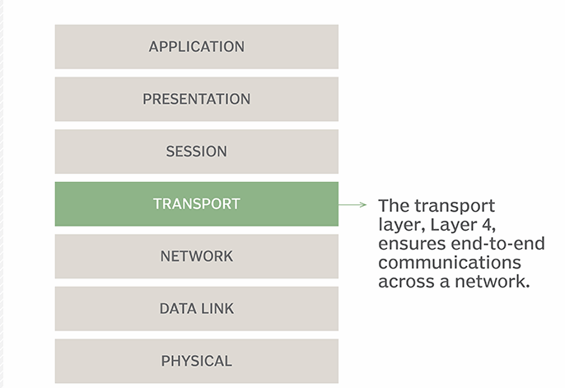
Transport layer
Positioned between the network layer and the session layer.
The network layer takes the data packets and forward them to the correct computer using IP addresses.
The transport layer then takes the received packets, convert the packets into segments checks for errors and missing packets and sort them out.
It then send the segments to the session layer for it to be received by correct application running on the receiving computer.
https://www.techtarget.com/searchnetworking/definition/Transport-layer
Transport Layer
3-<number>

Slide 5

















Transport services and protocols…
Provide logical communication between application processes running on different hosts
Transport protocols run on end systems
  Sender side: breaks application messages into segments, passes to the network layer
  Receiver side: reassembles segments into the original messages, passes the messages to the application layer
application
transport
network
data link
physical
logical end-end transport
application
transport
network
data link
physical
Transport Layer
3-<number>

Slide 6
Transport vs. network layer
Network layer: logical communication between hosts using IP addresses – Routing
Transport layer: logical communication between processes /applications
Transport layer relies on and builds on network layer services
Transport Layer
3-<number>

Slide 7
TCP (Transmission Control Protocol)
TCP is one of the core protocol of the internet/network.
It’s a connection-oriented protocol - ensures that a connection is firstly established before data exchanged.
It’s a protocol that ensures reliable and efficient end-to-end delivery of data between applications running on hosts in a network.
End-to-end refers to the communication directly between the two endpoints (client and a server).
TCP provides end-to-end communication by ensuring that 2 devices establish and maintain the connection to ensure data reliability.
It the ideal protocol for applications that highly require data integrity (web browsing, file transfers, email).
Transport Layer
3-<number>

Slide 8
TCP: Connection oriented
A connections is established between the sender and receiver prior to data transmission.
The TCP connection is kept active for the duration of the data transfer and terminated thereafter.
TCP uses the 3-Way Handshake mechanism to establish the connection.
TCP uses the 4-way Handshake mechanism to terminate the connection
Transport Layer
3-<number>

Slide 9
TCP: 3-Way Handshake
Mechanism used to establish the TCP connection between two devices following 3 steps.
1. SYN: The client sends a synchronization (SYN) packet to the server to initiate a connection. “I want to start a connection.”
2. SYN-ACK: The server responds with a synchronization -acknowledgment (SYN-ACK) packet. “I received your request and I’m ready.” The (SYN-ACK) packet acknowledges the requestion for connection.
3. ACK: The client acknowledges the server's response with an acknowledgment (ACK) packet. This ensures both sides are synchronized and data transfer can begin.
The SYN, SYN-ACK and ACK Number are flags used in the TCP 3 way –handshake during the connection setup process.
Transport Layer
3-<number>

Slide 10
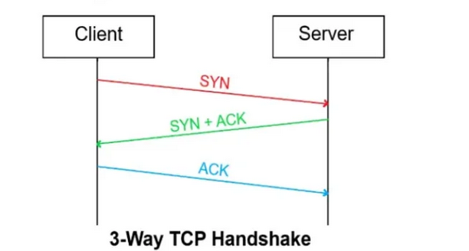
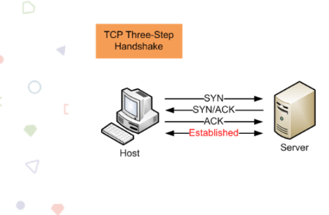
TCP: 3-Way Handshake
Transport Layer
3-<number>

Slide 11
TCP: 4-Way Handshake
Mechanism used to safely terminate the TCP connection between two devices following 4 steps.
1. FIN (Client): When the client wants to close the connection it sends a FIN packet to the server. “I’m done sending data.”
2. ACK (Server): The server responds with an ACK packet. The ACK packet acknowledges receipt of the request for connection termination.
“I got your request, you can stop sending.”
3. FIN (Server): The server then sends its own FIN packet to the client. The FIN packet indicates that the server is done sending data and ready to close the connection.
“I’m done sending data too.”
4. ACK (Client): The client responds with an ACK packet. Acknowledging receipt of the servers’ FIN packet.
“Got it, connection closed.”
FIN and ACK flags are used during this process to ensure both sides terminate the connection safely to avoid data loss.

Slide 12
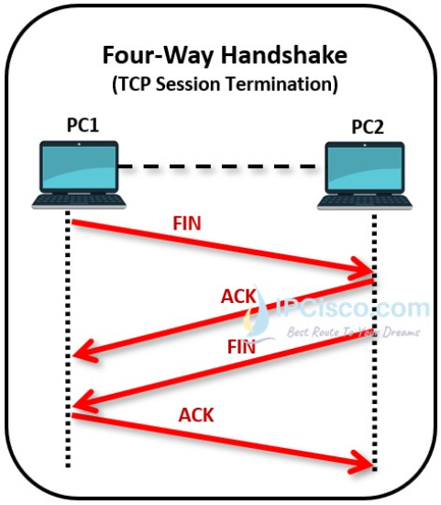
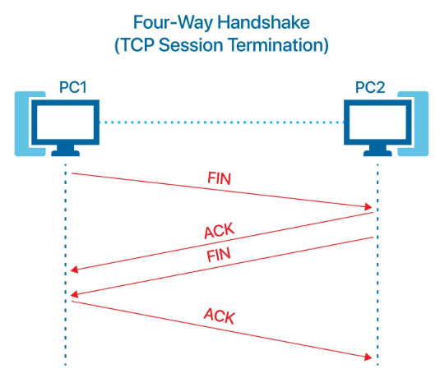
TCP: 4-Way Handshake
Transport Layer
3-<number>

Slide 13
TCP Drawbacks
High Overhead:
Extra processing for error checking, acknowledgments, and congestion.
Can increase latency and reduce network performance.
Complexity:
Implementing error control and reliable transmission mechanisms adds complexity.
Not Ideal for Real-Time Data:
Retransmissions and connection setup/teardown can cause delays, making TCP less suitable for real-time applications like video streaming or online gaming.

Slide 14
UDP (User Datagram Protocol)
It is a connectionless protocol – does not require for a connection to be established to send data - (faster than TCP)
Does not use acknowledgments or retransmit lost packets.
Used for applications that prioritise speed.
Ideal for real time applications (video streaming, online gaming, DNS lookup).
Key features of UDP
Connectionless: transmits data packets with no connection establishment required.
Unreliable: Does not guarantee arrival of data packets/ orderly arrival of data packets - Data packets may be lost or arrive out of order.
Low Latency: connectionless ensure low latency (fast)

Slide 15
UDP uses:
Real-Time Applications:
Used where fast delivery is more important than reliability.
Examples: video streaming, online gaming, voice/video calls.
DNS Lookups:
Used by the Domain Name System (DNS) to quickly resolve domain names to IP addresses.
Speed is important, so UDP is preferred.
Broadcast & Multicast Communication:
Used when data is sent to multiple devices at once on a network.
Example: A switch sending out ARP broadcast on a LAN

Slide 16
Transport layer
Key Functions of TCP
Segmentation: dividing bigger data chunks into units called segments.
Reassembly: Re-Assembling the segments back into the original data at the destination
Connection establishment: A connection is established before the data is transmitted (3-way handshake) .
Retransmission: Ensures reliable delivery of data using acknowledgments and retransmissions of dropped packets.
Error Control: Detects errors in transmitted data using checksums(small value calculated from the data and header of a segment).
Congestion control: regulates the rate at which packets are sent based on network congestion.
Flow Control: Prevents the sender from overwhelming the receiver with too much data by using the sliding window mechanism.
Transport Layer
3-<number>

Slide 17
TCP-Segmementation
Segmentation: Breaking large data into smaller units called segments for easier transmission over the network.
Each segment is assigned a sequence number, which helps the receiver reassemble the data in the correct order, even if segments arrive out of order.
Each segment contains a header that carries important control information.
Segment header Control Information
Source and Destination Port Numbers: Identify the sending and receiving applications.
Sequence Numbers: Ensures segments are reassembled in the correct order.
Flags: Indicate control messages (e.g., SYN, ACK, FIN ).
Checksum: Used for error detection to ensure data integrity.
Window Size: Used for flow control, indicating how much data can be sent at a time.
Transport Layer
3-<number>

Slide 18
TCP- Error Detection and Recovery
TCP ensures reliable delivery of data (segments) between devices on a network.
Error Control: Mechanisms used to detect and recover from errors that may occur during data transmission.
How TCP Handles Errors:
Checksum: Detects errors or corruption in transmitted data.
Acknowledgments (ACKs): Confirms successful delivery of segments.
Retransmission: Lost or corrupted segments are sent again.
Problems TCP detects and handles:
Packet loss – missing segments are retransmitted
Data corruption – detected using checksums
Out-of-order segments – reordered using sequence numbers
These mechanisms ensure data is delivered accurately and in the correct order, even over unreliable networks.

Slide 19
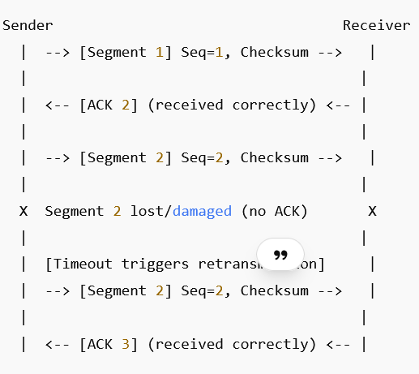
Error Detection and Correction

Slide 20
TCP-Flow control
Flow control : Technique employed by TCP to ensure that the sender doesn't overwhelm the receiver with too much data than the receiver can handle.
Flow control manages the rate of data transmission between the sender and receiver.
It prevents the receiver’s buffer from becoming overwhelmed, thus avoiding congestion and packet loss.
TCP Flow Control Operation:
1. The receiver informs the sender of the available buffer size (window size) /Sliding Window
2. The sender sends only the amount of data allowed by the window.
3. If the receiver’s buffer becomes full, the window size is set to 0, which pauses transmission.
4. When space becomes available, the receiver updates the window size, and the sender resumes sending data.
https://youtu.be/CtcSBokFg8k

Slide 21
TCP Congestion Control:
TCP Congestion Control technique that prevents the sender from overloading the network link by adjusting the data transmission rate based on the network conditions.
Prevents too much data from being sent into the network.
Helps prevent packet loss, delays, and network congestion
Ensures network stability and efficient data transmission.
How TCP Controls Congestion:
TCP maintains a Congestion Window (cwnd) at the sender to control how much data can be sent into the network.
The congestion window is adjusted dynamically based on the level of congestion in the network.
TCP estimates congestion by monitoring link traffic and packet loss.
If packets are dropped, TCP reduces the transmission rate to relieve congestion.
This regulation of the sending rate helps prevent packet loss and network overload, ensuring stable data transmission.
https://youtu.be/xv2m5PnX8rw

Slide 22
END
Application Layer
2-<number>

